Slide 1
Basic Electrical and Electronics Engineering
LECTURE 1.2
Dr. Sonam Shrivastava/ Assistant Professor (Sr.) /SELECT

Slide 2
BEEE102L
Basic Electrical and Electronics Engineering
DC Circuits
AC Circuits
Magnetic Circuits
Electrical Machines
Semiconductor Devices and Applications
Digital Systems

Slide 3
Books
Text Books
Allan R. Hambley, “Electrical Engineering -Principles & Applications”, 2019, 6th Edition, Pearson Education
V. D. Toro, Electrical Engineering Fundamentals, 2nd edition. PHI, 2014
Reference Books
R. L. Boylestad and L. Nashelsky, Electronic Devices and Circuit Theory, 11th edition. Pearson, 2012
DP Kothari & Nagrath, “Basic Electric Engineering”, 2019, Tata McGraw Hill

Slide 4
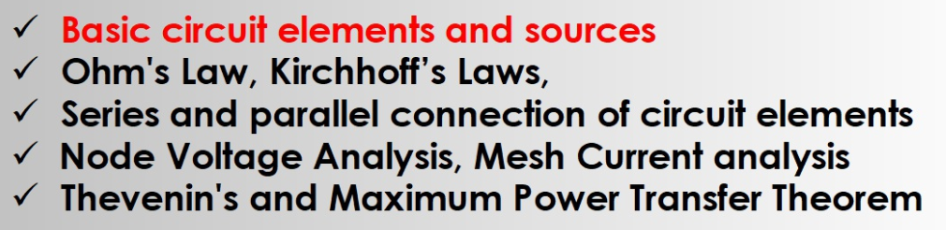
Module I. DC Circuits
Source transformation
Super position theorem

Slide 5
The Ideal Basic Circuit Element
i
Polarity reference for voltage can be
indicated by plus and minus signs
Reference direction for the current
is indicated by an arrow
+
v
_
Attributes:
Two terminals (points of connection)
Cannot be subdivided into other elements

Slide 6
A Note about Reference Directions
A problem like “Find the current” or “Find the voltage” is always accompanied by a definition of the direction:
i
- v +
In this case, if the current turns out to be 1 mA flowing to the left, we would say i = -1 mA
In order to perform circuit analysis to determine the voltages and currents in an electric circuit, you need to specify reference directions.

Slide 7
Circuit Elements
5 ideal basic circuit elements:
voltage source
current source
resistor
inductor
capacitor
Many practical systems can be modeled with just sources and resistors
The basic analytical techniques for solving circuits with inductors and capacitors are the same as those for resistive circuits
active elements, capable of
generating electric energy
passive elements, not capable of
generating electric energy

Slide 8
Electrical Sources
An electrical source is a device that is capable of converting non-electric energy to electric energy
Examples:
battery: chemical electric
dynamo (generator/motor): mechanical electric
Electrical sources can either deliver or absorb power

Slide 9
Ideal Independent and Dependent Voltage Sources
Circuit element that maintains a prescribed voltage across its terminals, regardless of the current flowing in those terminals.
Voltage is known, but current is determined by the circuit to which the source is connected.
The voltage can be either independent or depends on a voltage or current elsewhere in the circuit, and can be constant or time-varying.
Circuit symbols:
v_{s}
+
v_{s}=μ v_{x}
+
v_{s}=ρ i_{x}
+
_
_
_
independent
voltage-controlled
current-controlled

Slide 10
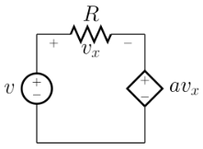
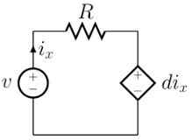
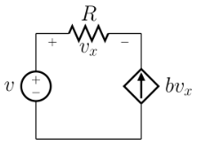
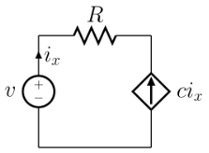
Dependent Sources
A dependent or controlled source is a voltage source or a current source whose value depends on a voltage or current somewhere else in the circuit.
Dependent sources are useful, for example, in modelling the behaviour of amplifiers, transistors etc.
(a) Voltage-Controlled Voltage Source (VCVS).
(b) Current-Controlled Voltage Source (CCVS).
(c) Voltage-Controlled Current Source (VCCS).
(d) Current-Controlled Current Source (CCCS).
(a) (b) (c) (d)

Slide 12
Electrical Resistance
Resistance: Electric field is proportional to current density, within a resistive material. Thus, voltage is proportional to current. The circuit element used to model this behavior is the resistor.
Circuit symbol:
Unit for R: Volts per Ampere ≡ ohms (Ω)
The current flowing in the resistor is proportional to the voltage across the resistor:
v = IR
where v = voltage (V), I = current (A), and R = resistance (Ω)
R
(Ohm’s Law)

Slide 13

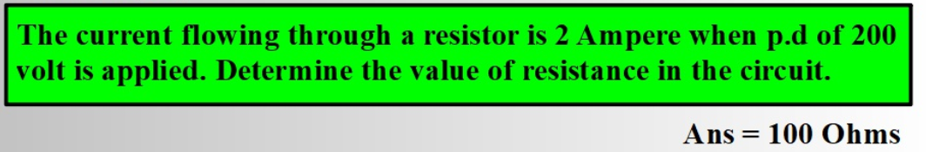
Ohm’s Law
Ohm’s law states that the current I flowing in a circuit is
directly Proportional to the applied voltage V and inversely
proportional to the resistance R, provided the temperature
remains constant.

Slide 14
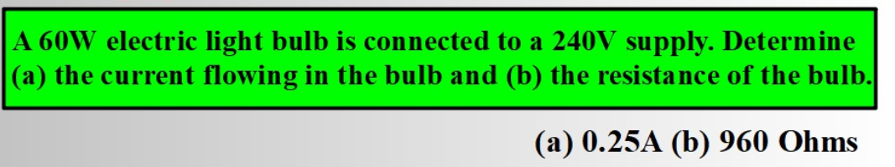

Slide 15
Electrical Conductance
Conductance is the reciprocal of resistance.
Symbol: G
Units: siemens (S) or mhos ( )
Example:
Consider an 8 Ω resistor. What is its conductance?
Ω

Slide 16
Short Circuit and Open Circuit
Wire (“short circuit”):
R = 0 → no voltage difference exists
(all points on the wire are at the same potential)
Current can flow, as determined by the circuit
Air (“open circuit”):
R = ∞ → no current flows
Voltage difference can exist, as determined by the circuit

Slide 17
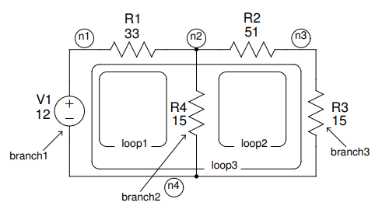
Circuit Nodes and Loops
A node is a point where two or more circuit elements are connected.
A loop is formed by tracing a closed path in a circuit through selected basic circuit elements without passing through any intermediate node more than once

Slide 18
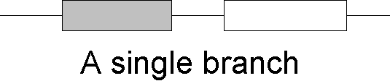
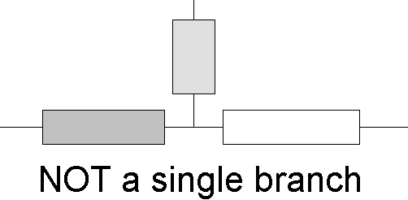
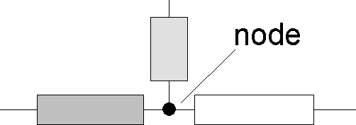
Terminology: Nodes and Branches
Node: A point where two or more circuit elements are connected (current division happens)
Branch: A path that connects two nodes

